Slide 1

3.Get data load

Slide 2


Let’s Create PowerBI from Scratch to Dashboard.
Where do I START?

Slide 3
Let’s Create PowerBI from Scratch to Dashboard.
We will be Looking on these 5 Features....
1.1 Get Data.
1.2 Relationships.
1.3 Dax: Measures & Calculated Columns.
1.4 Dax: Measure Magic!
1.5 Power BI Report and Dashboard

Slide 4
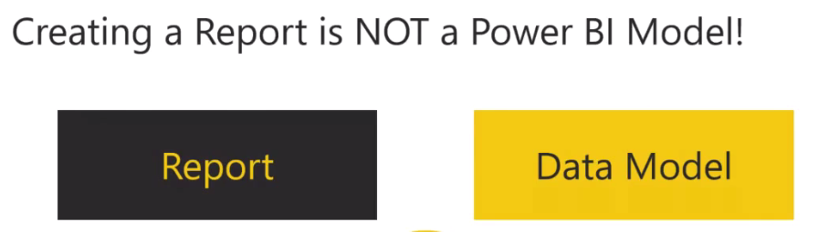
Let’s Create PowerBI from Scratch to Dashboard.
So, what is the difference between a report and a model?
It’s about asking questions??
A report gives you the answers that is exactly suits your need.
A data model gives you the answers that you haven’t asked about, not yet?

Slide 5
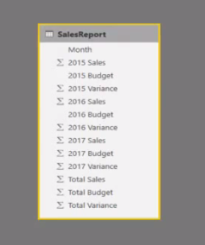
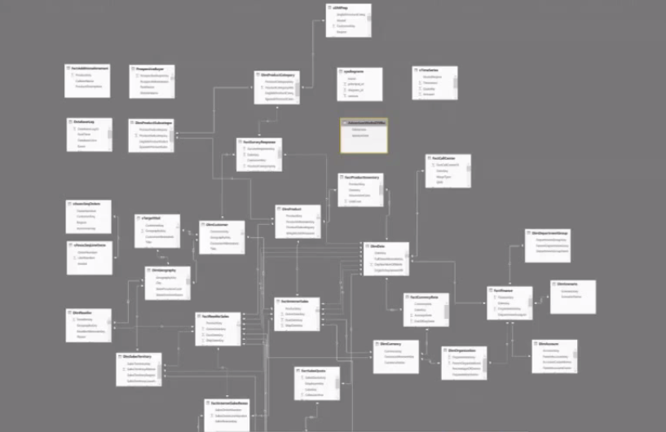
Let’s Create PowerBI from Scratch to Dashboard.
What is PowerBI?
It is an agile BI that provides short iterations, short measures and gives powerful datamodel to build amazing reports into dashboard.
What is NOT A POWERBI MODEL?
A complex table cannot be a PBI model.
A single table cannot be a PBI model

Slide 6

Let’s Create PowerBI from Scratch to Dashboard.
So, first do one thing important and that is
Let’s switch off the PowerBI for a moment.
Let’s swtich off from ”Get data”.
Let’s switch off from the computer.
START ON A WHITE BOARD!!
We will create reports, building query editors, applying dax measures and defining dashboards but later.

Slide 7
Let’s Create PowerBI from Scratch to Dashboard.
ASK QUESTIONS TO YOURSELF
What is the business process?
What are the measures or construct data table.? eg sales transaction, ship from warehouse, inventory, phonecall.
Based on this construct Lookup tables
Who is the buyer that will be your Customer table.
What they are going to buy that will be your Product table.
Where did they buy that will be your Territories table..
When did they buy that will be your Calendar table.
How did they buy that will be your Sales table.

Slide 8

Let’s Create PowerBI from Scratch to Dashboard.
So, the questions WHO, WHAT, WHERE, WHEN AND HOW makes your questions draw in below lookup tables.
customer
Product
Calendar
Area
Territories
Sales

Slide 9
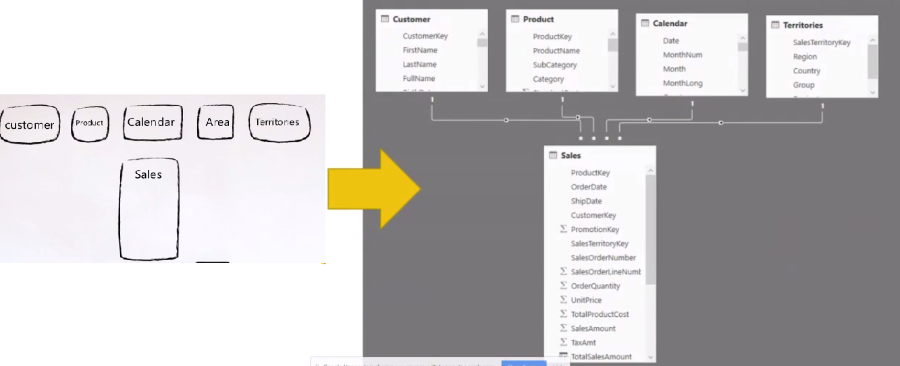
Let’s Create PowerBI from Scratch to Dashboard.
Bring your data to Life!!

Slide 10
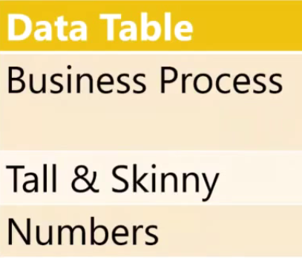
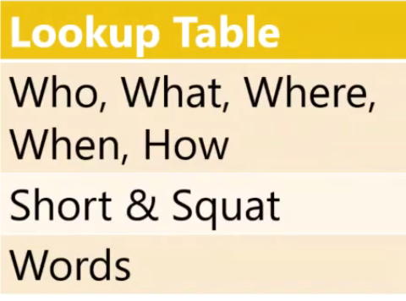
Let’s Create PowerBI from Scratch to Dashboard.
Thus, begin with data table.
Finish with Lookup table

Slide 11
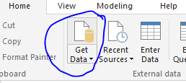
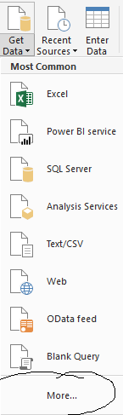
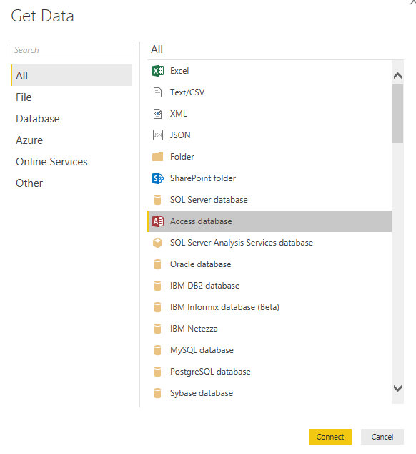
Let’s Create PowerBI from Scratch to Dashboard.
1.Get data from connectors
3.Access database connectors
If you want to download the dataset please follow the link in the end of the slides.
2. Get data connectors

Slide 12
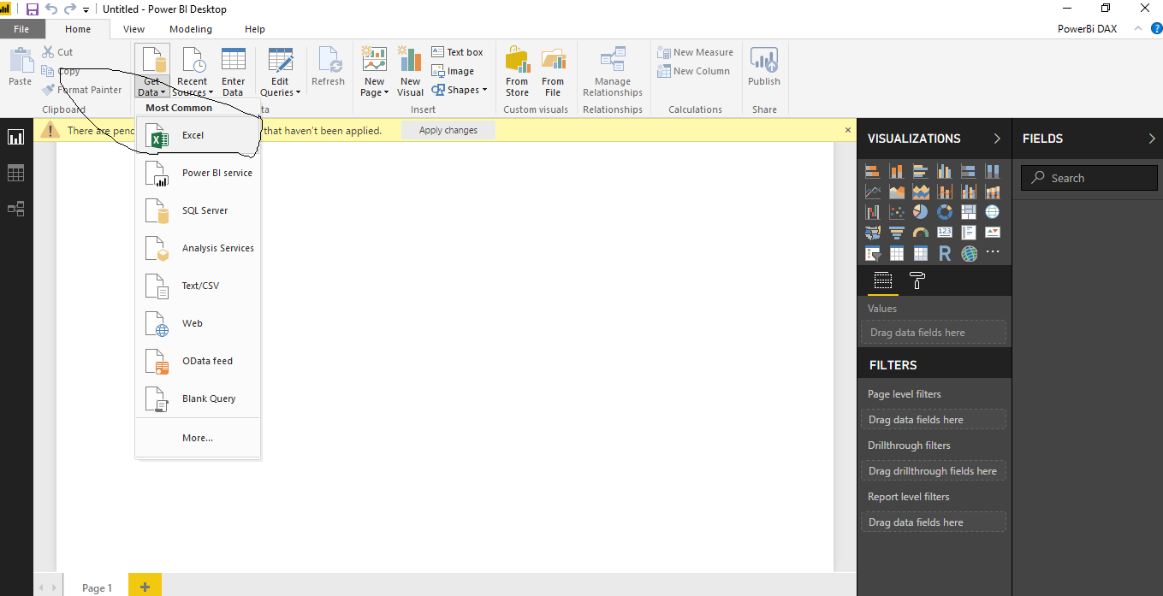
Let’s Create PowerBI from Scratch to Dashboard.
Use excel as the primary source of getting data.

Slide 13
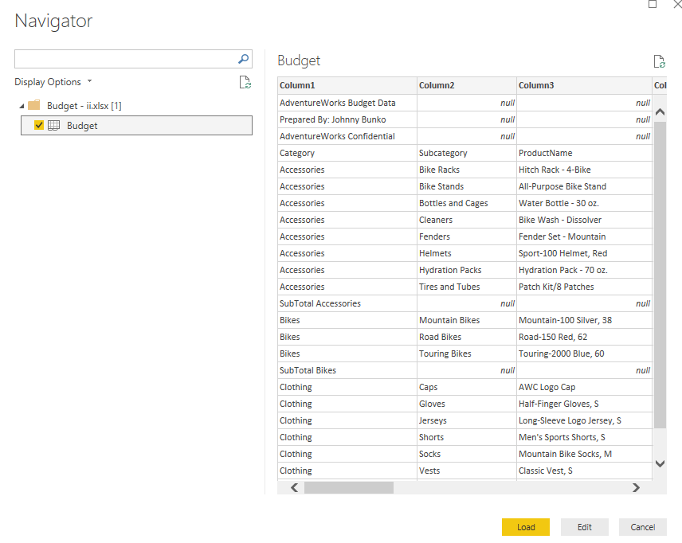
Let’s Create PowerBI from Scratch to Dashboard.
Budget as the primary source of data operations

Slide 14
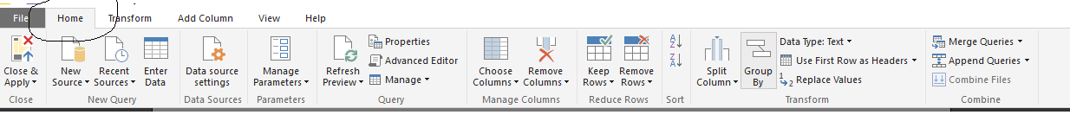
Let’s Create PowerBI from Scratch to Dashboard.
Close&Apply- This was done to ensure that Power Query loaded the data directly into the Power Pivot model without the overhead of having to also materialize the data in a worksheet.
New Source- New source of adding data using multiple data points.
Recent Source- Recent source of data used practically in it.
Enter Data- Enterdata manually directly to query editor.
Data Source Settings- It configures data source in current file and global settings.
Manage Parameters- Manage parameters to the query editor or adding new ones.
Refresh Preview- Refresh preview of data if we change anything on to the table.
Properties- Query properties with description of it.
Advanced editor- It helps to edit in the dataset.
Manage- Manage the delete, duplicate and refer the data as requirement.
Choose/Remove Column- Choose columns on adding and removing as requirement.

Slide 15
Let’s Create PowerBI from Scratch to Dashboard.
11. Keep/Remove Rows- Keep or remove rows in data as requirement.
12. Sort A-Z- Sorting of data alphabetically.
13. Split Column- Split the column as requirement for data.
14. Group by- The name of an existing column in the table (or in a related table,) by which the data is to be grouped
15. Data type- Converts the data types present in powerBi.
16. Used first row as headers- Used in the data set the first row contains column headers. We can simply set that to be used for columnheaders in Power Query.
17. Replace values- It helps to replace text values. In the Replace Values dialog box, enter Value To Find and Replace With.
18. Merge queries- It helps to merge queries in query editor.
19. Append queires- Append means results of two (or more) queries (which are tables themselves) will be combined into one query
20. Combine files-Combining queries is a big help in writing better and simpler queries.

Slide 16
Let’s Create PowerBI from Scratch to Dashboard.
Transpose: Transposing a data table is basically rotating your data from rows to columns, or from columns to rows.
Reverse Rows: Helps to reverse the order of rows very easily.
Count Rows: The COUNTROWS function counts the number of rows in the specified table
Data type: It better supports more efficient storage, calculations, and data visualization.
Detect Data type: It detects the data that is required for the storage.
Rename: It helps to rename a dashboard, report, or workbook.
Replace values: The Replace Values dialog box, enter value To find and replace with number.
Fill: It helps to fill the numbers.
Pivot/Unpivot column: Turning columns to rows, or rows to columns is easy with Power Query and Power BI. There are many situations that you get a name, value data source, and wants to convert that into columns with values underneath.
Move: Move and resize a visualization in a report in Power BI service and Power BI Desktop.
Convert to List: Helps to list on dates, expand on lists, convert the numbers.
Extract: Extract data from visualisation, text comparisons or any other sources.
Parse: It is the process of analysing a string of symbols,data and digits.
Run R as script: Helps to run the R script as required by the user.

Slide 17
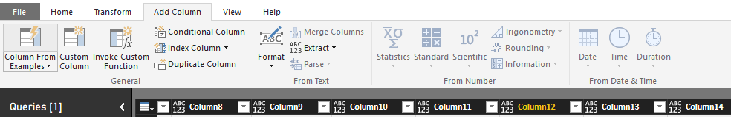
Let’s Create PowerBI from Scratch to Dashboard.
Columns from examples: To create a new column from an example, launch Query Editor. You can do this by selecting Edit Queries from the Home ribbon in Power BI Desktop.
Custom Column:You can easily add a new custom column of data to your model using Query Editor in Power BI Desktop. You can create and rename your custom column using easy buttons to create M formulas that define your custom column.

Slide 18
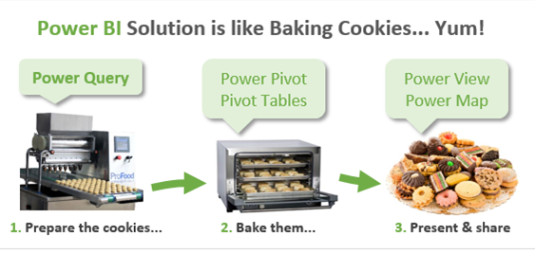

Slide 19
Downloads
To install PowerBI from Microsoft
https://powerbi.microsoft.com/en-us/desktop/?WT.mc_id=Blog_Desktop_Update
Microsoft One drive
https://onedrive.live.com/?authkey=%21AAgrneBx3oI8Rak&id=B5A9CCD6892588B1%21423&cid=B5A9CCD6892588B1
Microsoft Onedrive data sets
https://onedrive.live.com/?id=7B84B0F2C239489A%212078&cid=7B84B0F2C239489A

Slide 20



Resources
Get Power BI (Free) http://tinyurl.com/hj5hdg6
Power BI Jump Start http://bit.ly/1ktON16
Power BI Getting Started http://bit.ly/1FF88KA
Power BI Team Blog http://bit.ly/1vwbTLG
Power BI Channel 9 http://bit.ly/1a9Q0gv
Power BI https://powerbi.microsoft.com

Slide 21
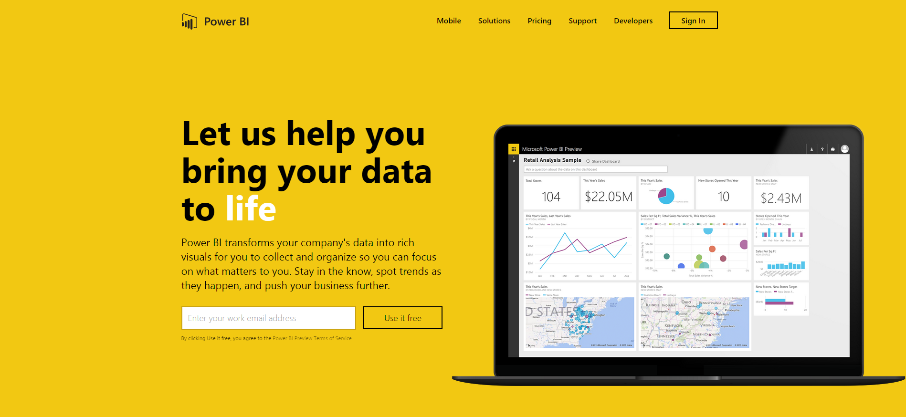
Thankyou for Coming to PowerBI
Sign up for a free Preview account
Take the Power BI Tour
Notes:
Thanks for taking the time to walk through the main capabilities of Power BI.
If you’re ready to start exploring what Power BI can do for you and your organization, please visit powerbi.com.

